Slide 1

Session 7 – Python
Brief Intro to Machine Learning with Scikit Learn
Dataset Collection
Doug Bowman

Slide 2
Dataset Collection
Overview
  Pulling Data from Scikit-Learn Datasets
  Pulling Data from CSV
  Pulling Data from Excel
  Pulling Data from SQL Databases
  Pulling Data from Website

Slide 3
Dataset Collection
Pulling Data from Scikit-Learn Datasets
  Sckit-Learn comes with many datasets that are gathered from calling a function
  Under sklearn.datasets
  Creates dictionaries that include data, descriptions, feature names, targets, target names, etc
  Eg: from sklearn.datasets import load_iris

Slide 4
Dataset Collection
Pulling Data from Scikit-Learn Datasets
  3 types:
    Fetch
      Pulls data from internet
      Ex: from sklearn.datasets import fetch_california_housing
    Load
      Pulls data from local library
      Ex: from sklearn.datasets import load_iris
    Make
      Generates data from input
      Ex: from sklearn.datasets import make_swiss_roll

Slide 5
Dataset Collection
Class Example
  Load iris data and show keys

Slide 6

Dataset Collection
In-Class Exercise
  Load each type of data, and plot the data for visualization (where applicable):
    Fetch
    Load
    Make

Slide 7
Dataset Collection
Pulling Data from CSV
  Can import CSV data directly into a Pandas dataframe
    pd.read_csv
  Can also load data opening a CSV as a text file, and manually storing data in a structure.
    With open() syntax

Slide 8
Dataset Collection
Pulling Data from CSV
  Can also use csvreader class
    Allows specification of:
      Element delimiters
      Quote characters
      Autoremoval of newline characters

Slide 9
Dataset Collection
Pulling Data from CSV
  A note about CSV data in general
    Not a well-utilized standard.
    The styles can vary widely
    Some styles use double-quotes around every element
    Some styles only put double-quotes around elements that contain spaces
    Be sure to double-check your data once it is pulled to ensure all elements have been separated out.

Slide 10
Dataset Collection
Class Example
  Loading data in a CSV format
    Using pandas
    Opening file like a text file
    Using csvreader

Slide 11
Dataset Collection
In-Class Exercise
  Using CSV data of your choice, load data into a pandas DataFrame and/or container datatype of your choice using the 3 methods discussed:
    Pandas read_csv()
    Reading the CSV file as a text file
    Using csvreader()

Slide 12
Dataset Collection
Pulling Data from Excel
  Can use pandas read_excel function.
  Newer openpyxl engine can read .xlsx files.
  Xlrd engine reads older .xls files.
  Pandas will automatically determine the correct engine to use.
  Sometimes can get an issue with the encoding of the file that needs adjusted.

Slide 13
Dataset Collection
Class Example
  Loading data in Excel format into a pandas DataFrame.
  Changing encoding of file

Slide 14
Dataset Collection
Pulling Data from OpenData Sheets
  Can use pandas read_excel function.
  If the function doesn’t understand the file, can import the odfpy library, and use the ‘ODF’ engine when reading the file.

Slide 15
Dataset Collection
Class Example
  Loading open datasheet format files

Slide 16
Dataset Collection
In-Class Exercise
  Using sheet data of your choice (either ods or Excel), load data into a pandas DataFrame.

Slide 17
Dataset Collection
Pulling Data from SQL Databases
  Can use Pandas read_sql()
  Will need a connection string to tell Python what to connect to, and how to connect to it.
  Will need a valid query string to tell database what data is needed.

Slide 18
Dataset Collection
Class Example
  Loading SQLite database.

Slide 19
Dataset Collection
In-Class Exercise
  Using a database of your choice, pull data from the following database objects:
    Table
    View
    Custom query
  See class example file for location of SQLite database if you’d like to use that.

Slide 20
Dataset Collection
Pulling Data from Website
  Urllib
  BeautifulSoup
  Parsing XML
  Parsing JSON

Slide 21
Dataset Collection
urllib
  Used to connect to websites via HTTP
  Works similar to reading files with open()
  Create a webfile handle with urllib.request.urlopen(<html_url>)
    <html_url> is the webpage you wish to read.
    Must be an HTTP site

Slide 22
Dataset Collection
BeautifulSoup
  Used to parse and analyze HTML structure.
  Part of the bs4 library
  Creates an object that has HTML tags as properties.
    soup.head
    soup.body
    soup.p
    etc

Slide 23
Dataset Collection
BeautifulSoup
  Helper functions can be used to retrieve specific data
    Certain attributes
    Certain number of specific elements/text
    Tags with certain id’s

Slide 24
Dataset Collection
BeautifulSoup
  <soup_property>.find_all(<element_string>)
    Finds all children elements specified.
    Recursive.
    Returns a list of all finds.
      soup.head.find_all('meta') returns all <meta> elements.
      soup.body.find_all(‘a’) finds all <a> reference elements in the body.

Slide 25
Dataset Collection
BeautifulSoup
  <soup_property>.find_all(<element_string>)
    Can use a list to find more than one element.
      soup.body.find_all(['p','a']) gets all <p> and <a> elements in the <body>

Slide 26
Dataset Collection
BeautifulSoup
  <soup_property>.get()
    Gets a specific attribute of a specified BeautifulSoup property.
    If more than one matches occur, only the first is returned.
      soup.body.p.get('style') returns each style from each <p> tag in the body.
      soup.body.a.get('href') will return the values of each href from each <a> within the body of the webpage.

Slide 27
Dataset Collection
BeautifulSoup
  Go over in-class examples.

Slide 28
Dataset Collection
In-Class Exercise
  Find all references from a webpage.
  Get only the links to JavaScript libraries from a webpage.
    Example webpage: https://blog.perkinelmer.com/posts/gas-chromatography-explained-what-it-is-and-how-it-works/
  From your favorite python package, get the package name and URL from pypi
    For instance, Sphinx can be found at https://pypi.org/simple/sphinx/
  Get the URL’s for all the US mirrors for GCC compilers from
    Mirrors can be found at https://gcc.gnu.org/mirrors.html
    Only need to look in the /releases/ folder

Slide 29
Dataset Collection
Parsing XML
  eXtensible Markup Language
  Uses tags to denote information and structure
  XML elements are XML’s version of statements
  Programmer-defined tags identify top of information, similar to a variable name
    Angle bracket denoted
    Children elements are declared between the open and closing tags.
      <book>
        <title>The Count of Monte Cristo</title>
        <author>Alexandre Dumas</author>
      </book>

Slide 30
Dataset Collection
XML Namespaces
  Xmlns defines what each tag means
  Namespaces allow for multiple specifications and can separate out same-name tags that mean different things.

Slide 31

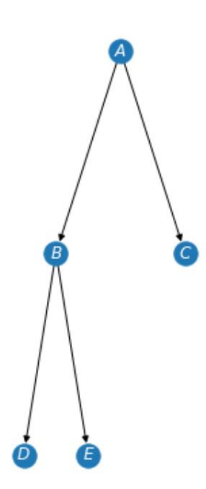
Dataset Collection
XML Namespaces
  <trees xmlns:arborist=”http://this.is.a.fake.site.for.arborists.com”
      xmlns:data_struct=”http://this.is.a.fake.site.for.data.structs.com”>
    <arborist:tree>
      <arborist:type>Red Maple</arborist:type>
      <arborist:leaf_color>red</arborist:leaf_color>
      <arborist:bark>rough</arborist:bark>
    </arborist:tree>
    <data_struct:tree>
      <data_struct:node>A</data_struct:node>
      <data_struct:node>B</data_struct:node>
      <data_struct:node>C</data_struct:node>
      <data_struct:node>D</data_struct:node>
      <data_struct:node>E</data_struct:node>
      <data_struct:edge>A->B</data_struct:edge>
      <data_struct:edge>A->C</data_struct:edge>
      <data_struct:edge>B->D</data_struct:edge>
      <data_struct:edge>B->E</data_struct:edge>
    </data_struct:tree>
  </trees>

Slide 32
Dataset Collection
XML Attributes
  Attributes are an additional place data can be stored.
  Stored in the tag of an element vs a child node.
  Example underlined below:
  <arborist:tree mi_population=”154000”>
    <arborist:type>Red Maple</arborist:type>
    <arborist:leaf_color>red</arborist:leaf_color>
    <arborist:bark>rough</arborist:bark>
  </arborist:tree>

Slide 33
Dataset Collection
XML Attributes
  No rules on which data should be an attribute and which data should be a child element.
  Can gather using the xml module

Slide 34
Dataset Collection
XML
  Go over in-class examples.

Slide 35
Dataset Collection
In-Class Exercise
  Get all the plant names from the W3 schools example XML file at https://www.w3schools.com/xml/plant_catalog.xml
  Using the same plant XML file, sort the data by hardiness zone. Select an appropriate data structure in Python to hold the data.
  Get the XML string from https://learn.microsoft.com/en-us/previous-versions/windows/desktop/ms762271(v=vs.85), and convert the data into a CSV or spreadsheet file.
    Hint: Look for the <code> tag
  Using the class example namespace xml file, get the text of all edges
    File located at ./PracticalProgramming/Session 7 - Python/Instructional Material/In-Class Exercises/namespace_example.xml.

Slide 36
Dataset Collection
Parsing JSON
  JavaScript Object Notation
  Stores data structure in a string format.
    Objects are stored in curly braces
      Interpreted as dictionaries to Python
    Arrays are stored in square brackets
      Interpreted as lists in Python
    Other primitive data types are stored as you would expect

Slide 37
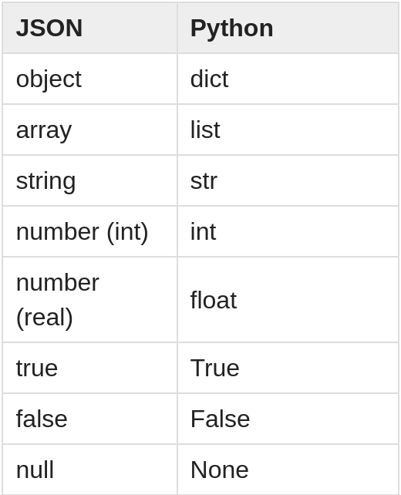
Dataset Collection
Parsing JSON
  JavaScript Object Notation
  Stores data structure in a string format.
    Other types:
[20]

Slide 38
Dataset Collection
Parsing JSON
  Standard can be found at https://www.ecma-international.org/publications-and-standards/standards/ecma-404/

Slide 39
Dataset Collection
Parsing JSON
  Simple example:
    {"widget": {
    "debug": "on",
    "window": {
    "title": "Sample Konfabulator Widget",
    "name": "main_window",
    "width": 500,
    "height": 500
    },
    "image": {
    "src": "Images/Sun.png",
    "name": "sun1",
    "hOffset": 250,
    "vOffset": 250,
    "alignment": "center"
    },
    "text": {
    "data": "Click Here",
    "size": 36,
    "style": "bold",
    "name": "text1",
    "hOffset": 250,
    "vOffset": 100,
    "alignment": "center",
    "onMouseUp": "sun1.opacity = (sun1.opacity / 100) * 90;"
    }
    }}

Slide 40
Dataset Collection
Parsing JSON
  Can use the json library to convert to and from JSON using objects.
    JSONDecoder class converts JSON string to Python data types based on the table shown in a previous slide
    JSONEncoder class converts Python structures/types to a JSON string.

Slide 41
Dataset Collection
Parsing JSON
  Go over in-class JSON examples.

Slide 42
Dataset Collection
In-Class Exercise
  Get the size of the fruit from the data at https://support.oneskyapp.com/hc/en-us/article_attachments/202761627/example_1.json
    This is the first URL example in the in-class code
  Create a key-value pair for the questions to answers from the data at https://support.oneskyapp.com/hc/en-us/article_attachments/202761727/example_2.json
    This is the URL from the 2nd JSON web example in the in-class code.
  Get the names of all the servlets from the web-app at https://json.org/example.html
    This one will require HTML parsing, as well as JSON.
    Try to use the JSON library to get the servlet names, not just BeautifulSoup
  Extra credit: convert the JSON data to XML data from the website http://ergast.com/api/f1/2004/1/results.json

Slide 43

Bibliography
https://github.com/amueller/introduction_to_ml_with_python/blob/master/02-supervised-learning.ipynb
Müller, A. C., & Guido, S. (2016). Introduction to Machine Learning with Python: A Guide for Data Scientists (1st ed.). O’Reilly Media.
http://rasbt.github.io/mlxtend/user_guide/general_concepts/gradient-optimization/

Slide 44
Bibliography
https://github.com/ageron/handson-ml
Géron Aurélien. Hands-on Machine Learning with Scikit-Learn and Tensorflow. 1st ed., O'Reilly, 2017.
https://machinelearningmastery.com/how-to-use-correlation-to-understand-the-relationship-between-variables/

Slide 45
Bibliography
Harrison, Matt. Machine Learning Pocket Reference: Working with Structured Data in Python. 1st ed., O'Reilly, 2019.
https://scikit-learn.org/stable/modules/cross_validation.html
Scikit-learn: Machine Learning in Python, Pedregosa et al., JMLR 12, pp. 2825-2830, 2011.

Slide 46
Bibliography
API design for machine learning software: experiences from the scikit-learn project, Buitinck et al., 2013.
https://docs.scipy.org/doc/scipy/reference/generated/scipy.stats.pearsonr.html
https://docs.scipy.org/doc/scipy/reference/generated/scipy.stats.spearmanr.html#scipy.stats.spearmanr

Slide 47
Bibliography
https://www.investopedia.com/terms/p/p-value.asp
https://scikit-learn.org/stable/auto_examples/manifold/plot_swissroll.html#sphx-glr-auto-examples-manifold-plot-swissroll-py
https://scikit-learn.org/stable/auto_examples/manifold/plot_compare_methods.html#sphx-glr-auto-examples-manifold-plot-compare-methods-py

Slide 48
Bibliography
16) https://wizardforcel.gitbooks.io/scikit-and-tensorflow-workbooks-bjpcjp/content/ch08-dimensionality-reduction.html
17) https://pub.towardsai.net/principal-component-analysis-in-dimensionality-reduction-with-python-1a613006d531
18) https://towardsdatascience.com/the-kernel-trick-c98cdbcaeb3f

Slide 49
Bibliography
19) https://cs.nyu.edu/~roweis/lle/papers/lleintro.pdf
20)https://docs.python.org/3/library/json.html
21)https://academic.oup.com/bioinformatics/article/24/18/2010/190849?login=false
22)https://arxiv.org/pdf/1904.10416.pdf
23)

Slide 50
Additional Resources
https://towardsdatascience.com/over-fitting-and-regularization-64d16100f45c
https://towardsdatascience.com/scale-standardize-or-normalize-with-scikit-learn-6ccc7d176a02

Slide 51
LICENSE
Copyright 2022 Douglas Bowman
Permission is hereby granted, free of charge, to any person obtaining a copy of this software and associated documentation files (the "Software"), to deal in the Software without restriction, including without limitation the rights to use, copy, modify, merge, publish, distribute, sublicense, and/or sell copies of the Software, and to permit persons to whom the Software is furnished to do so, subject to the following conditions:
The above copyright notice and this permission notice shall be included in all copies or substantial portions of the Software.
THE SOFTWARE IS PROVIDED "AS IS", WITHOUT WARRANTY OF ANY KIND, EXPRESS OR IMPLIED, INCLUDING BUT NOT LIMITED TO THE WARRANTIES OF MERCHANTABILITY, FITNESS FOR A PARTICULAR PURPOSE AND NONINFRINGEMENT. IN NO EVENT SHALL THE AUTHORS OR COPYRIGHT HOLDERS BE LIABLE FOR ANY CLAIM, DAMAGES OR OTHER LIABILITY, WHETHER IN AN ACTION OF CONTRACT, TORT OR OTHERWISE, ARISING FROM, OUT OF OR IN CONNECTION WITH THE SOFTWARE OR THE USE OR OTHER DEALINGS IN THE SOFTWARE.

